Slide 1
Traditional Graph Machine Learning

Slide 2
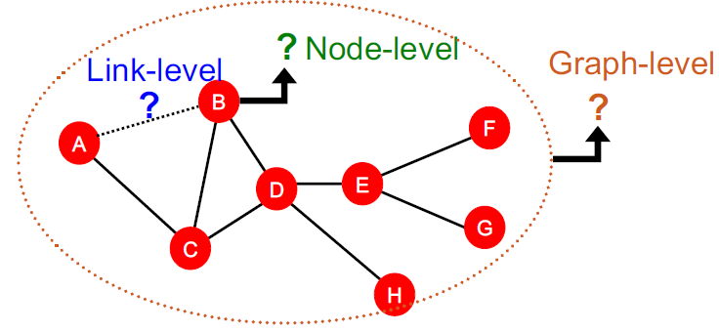
Predictions in Graphs
Node Level Prediction
Edge Level Prediction
Graph Level Prediction

Slide 3
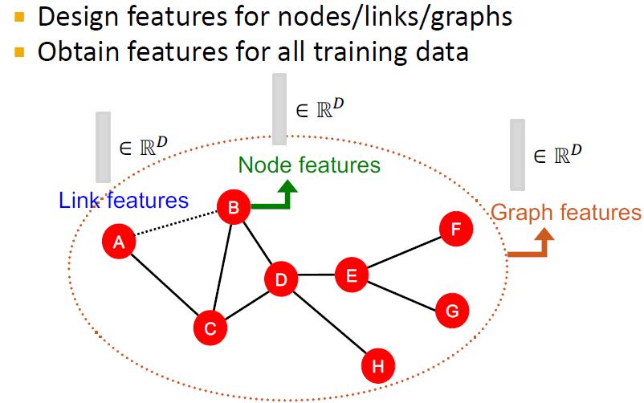
Traditional ML Pipeline

Slide 4
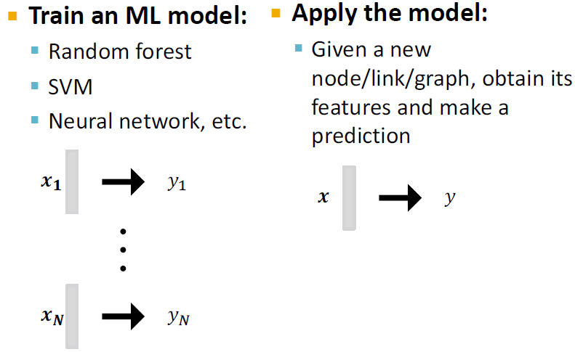
Traditional ML Pipeline
Relies on Effective Feature Engineering
Traditional ML relies on hand-designed features

Slide 5
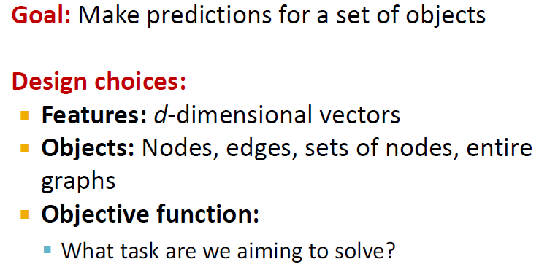
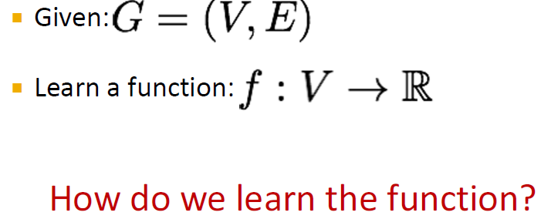
Machine Learning in Graphs

Slide 6
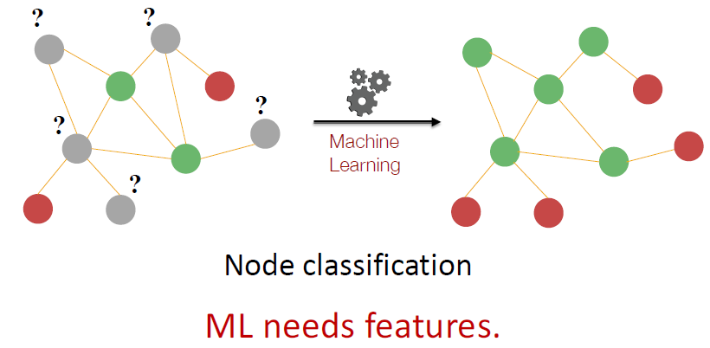
Node Classification Task

Slide 7
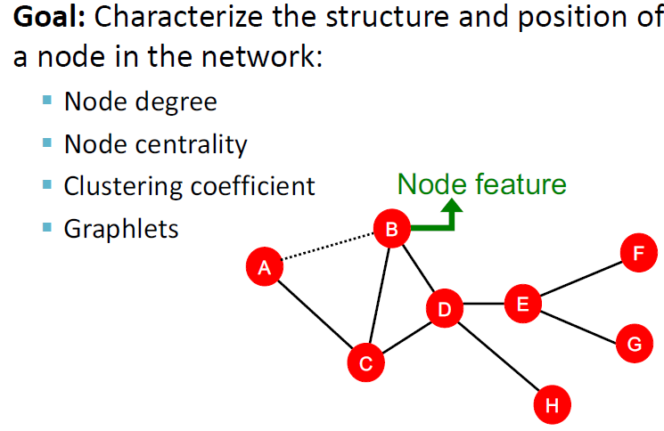
Node Level Features

Slide 8
Node Level Features
Node degrees : Simple but treats each of the neighbors equally
Node Centrality : Measures node importance
Eigen Vector, PageRank, Betweenness, Closeness
Clustering Coefficient : Measures cohesiveness
Counts # of triangles in the graph
We can generalize the counting to a pre-specified subgraph size (Graphlets)
Graphlet counts

Slide 9
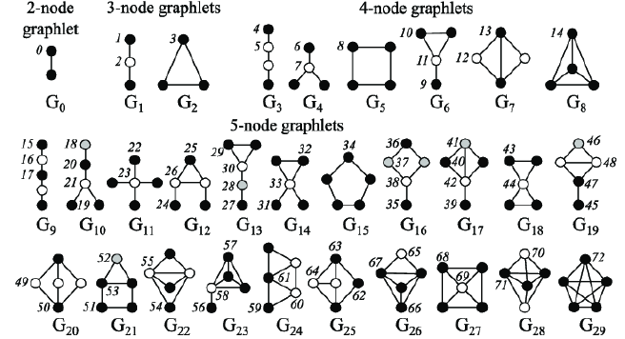
Node Level Features
Graphlets
Rooted connected non-isomorphic subgraphs

Slide 10
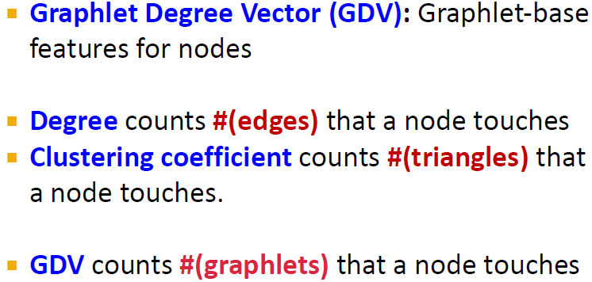
Node features: Graphlets

Slide 11
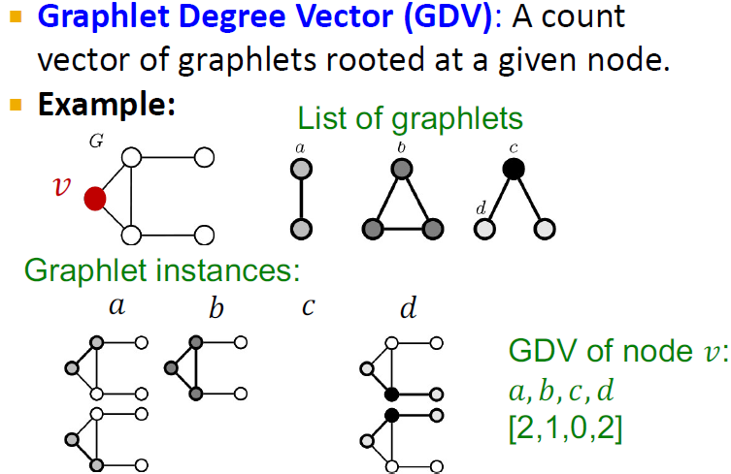
Node Features: Graphlets

Slide 12
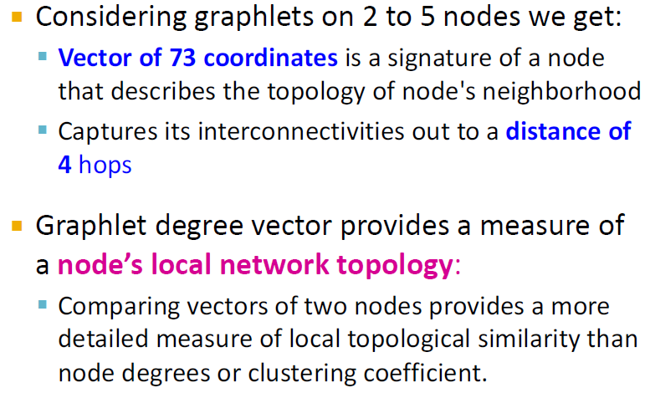
Node Features: Graphlets

Slide 13
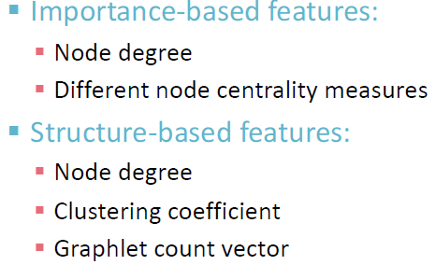
Node Level Feature Summary

Slide 14
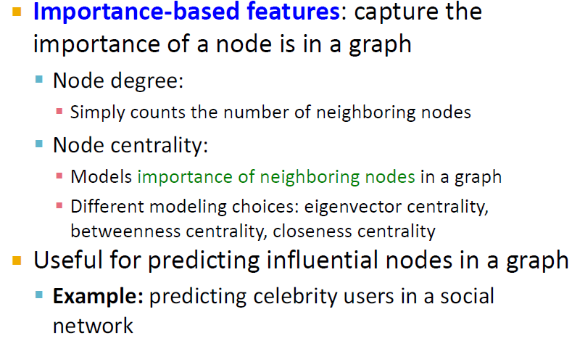
Node Level Feature Summary

Slide 15
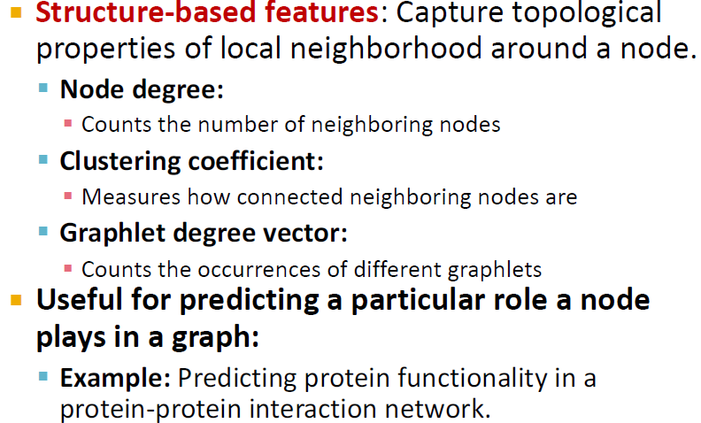
Node Level Feature Summary

Slide 16
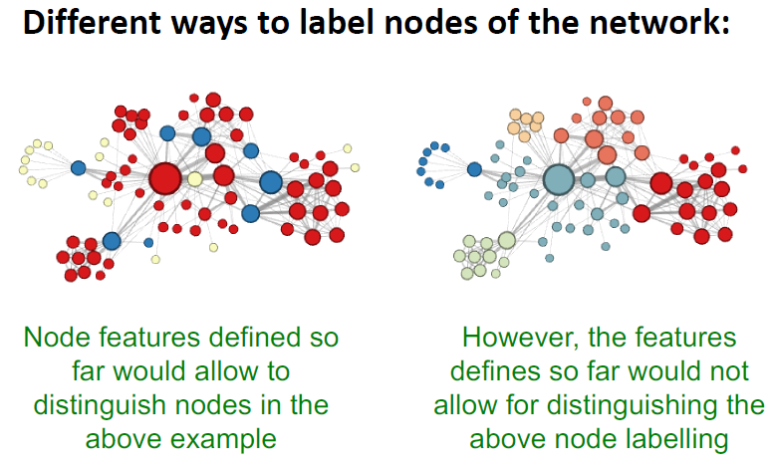
What it still misses?

Slide 17
Link Level Prediction Tasks

Slide 18
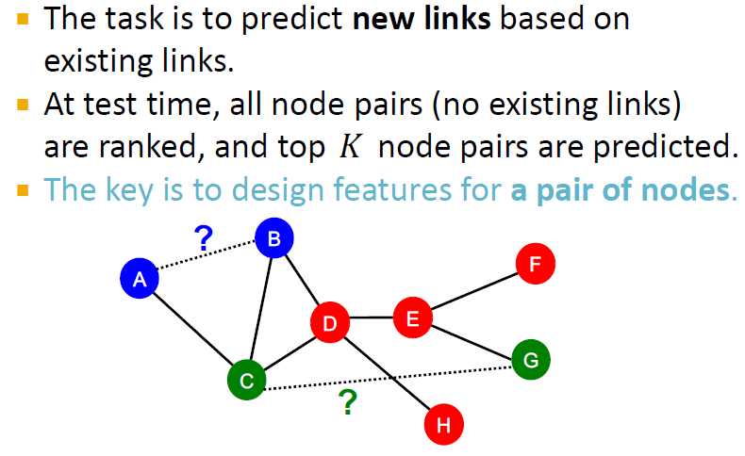
Link Level Prediction

Slide 19
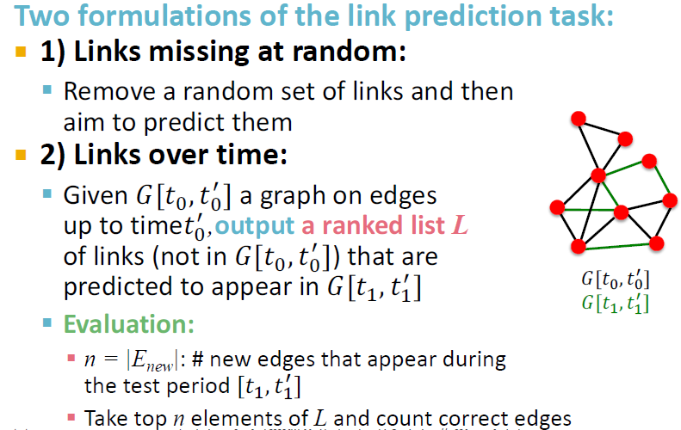
Link Prediction as a task

Slide 20
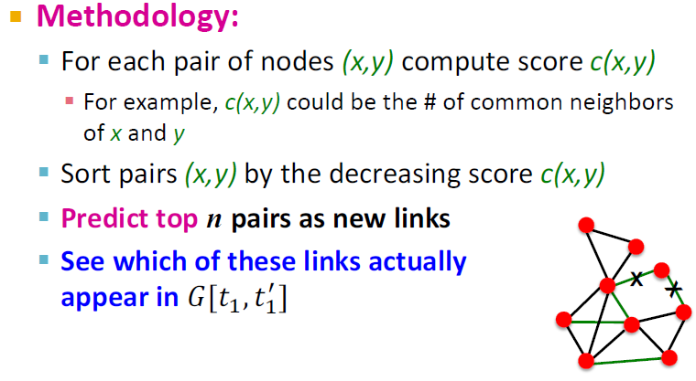
Link Prediction via Proximity

Slide 21
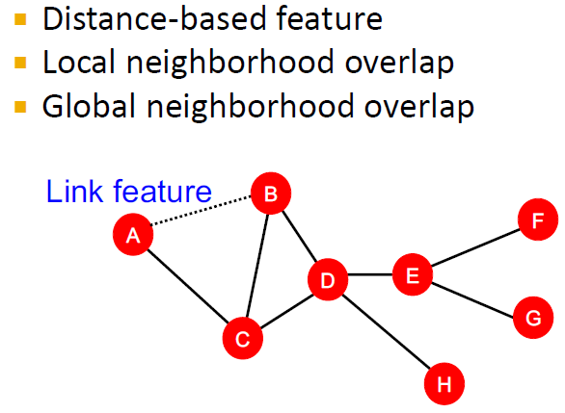
Link Level Features

Slide 22
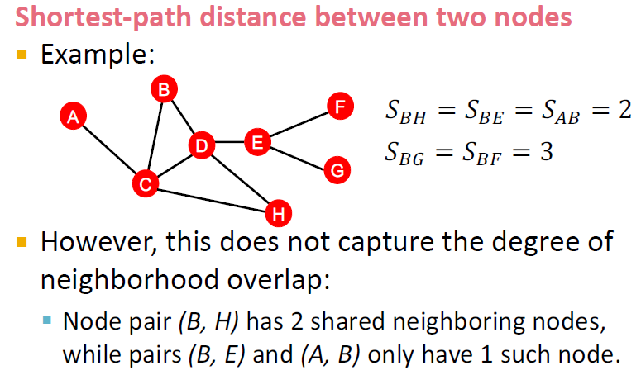
Distance based features

Slide 23
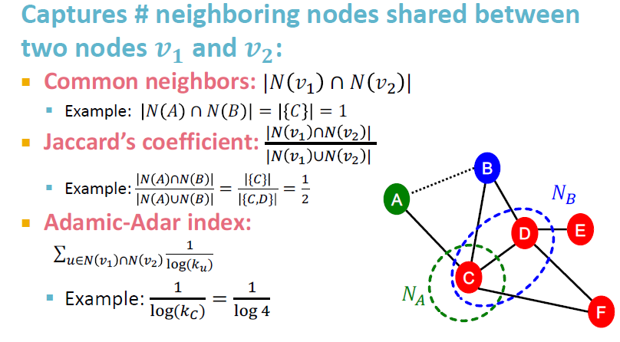
Local Neighborhood Overlap

Slide 24
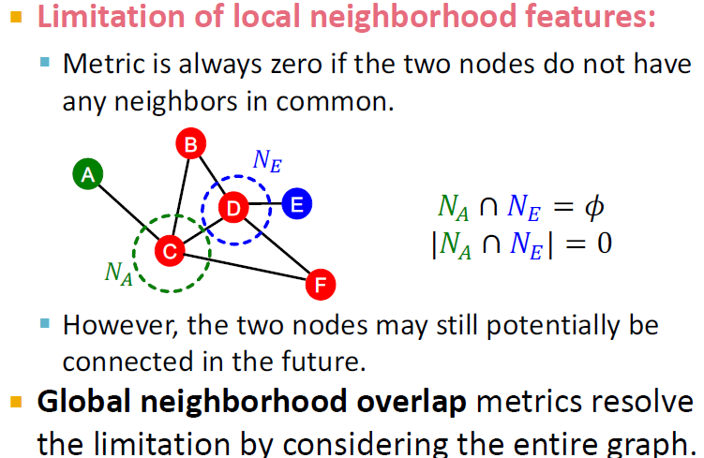
Global Neighborhood Overlap

Slide 25
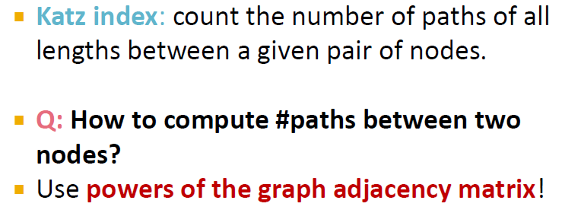
Global Neighborhood

Slide 26
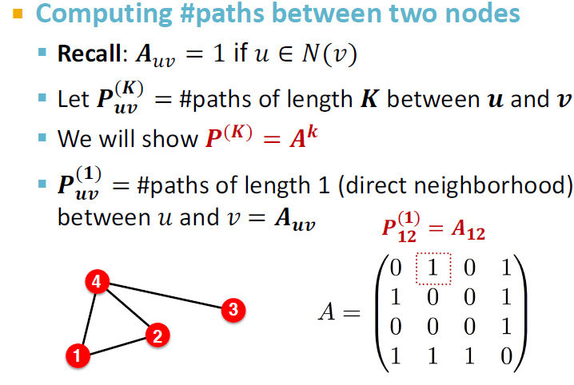
Power of Adjacency matrices

Slide 27
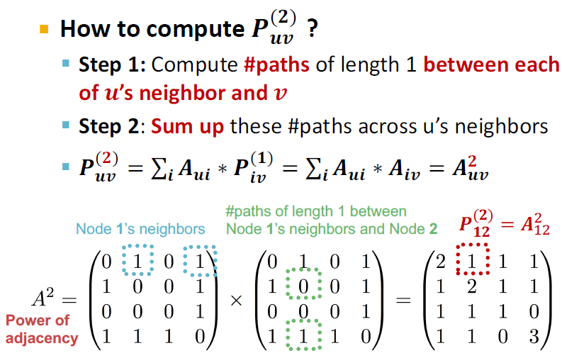
Power of Adjacency matrix

Slide 28
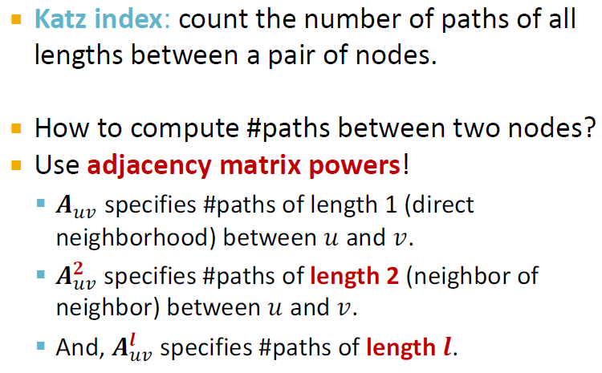
Global Neighborhood Overlap

Slide 29
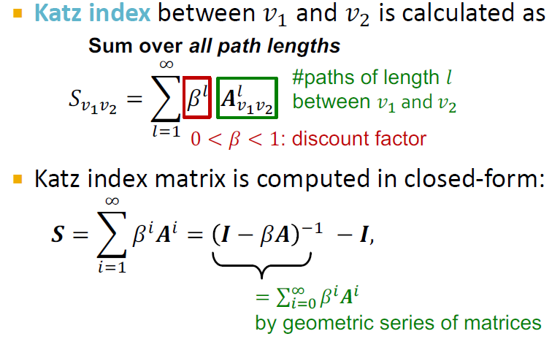
Global Neighborhood Overlap

Slide 30
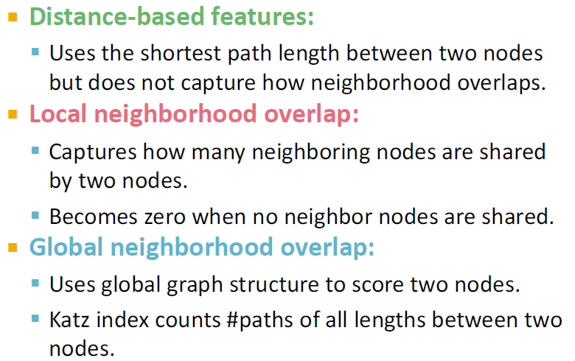
Link Level Features Summary

Slide 31
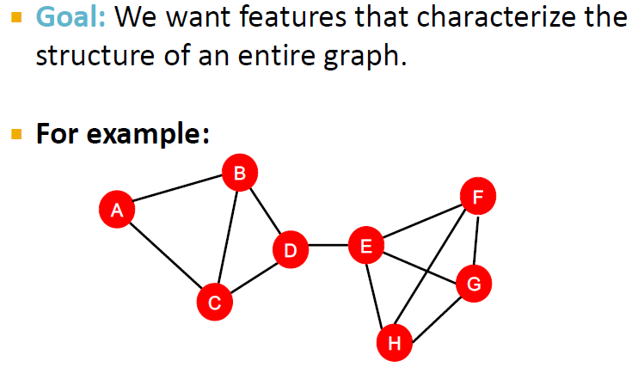
Graph Level Features

Slide 32
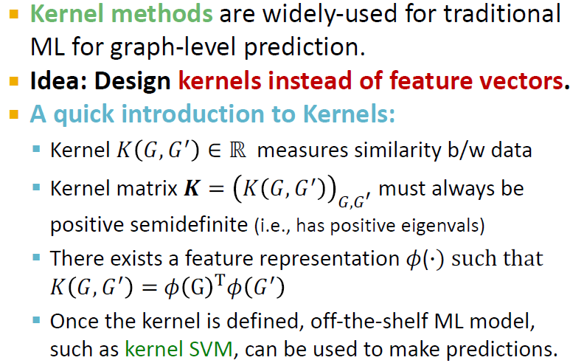
Kernel Methods

Slide 33
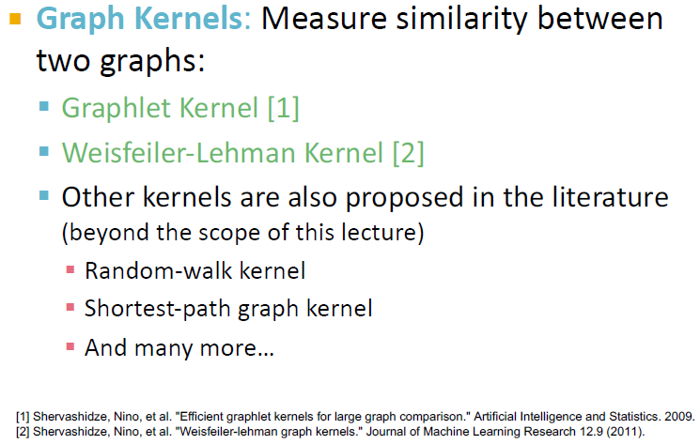
Graph Level Features

Slide 34
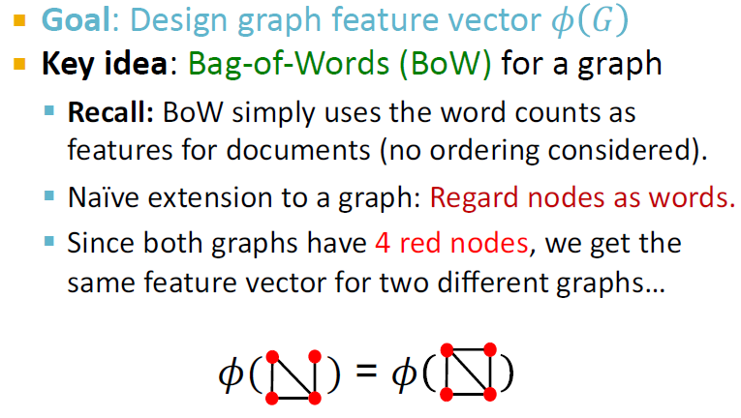
Graph Kernel

Slide 35
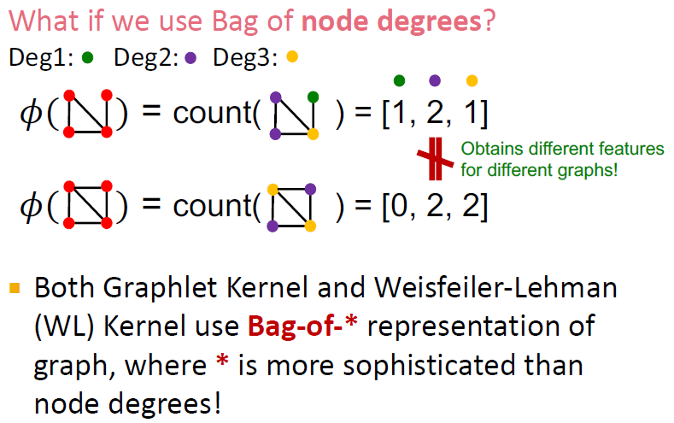
Graph Kernel

Slide 36
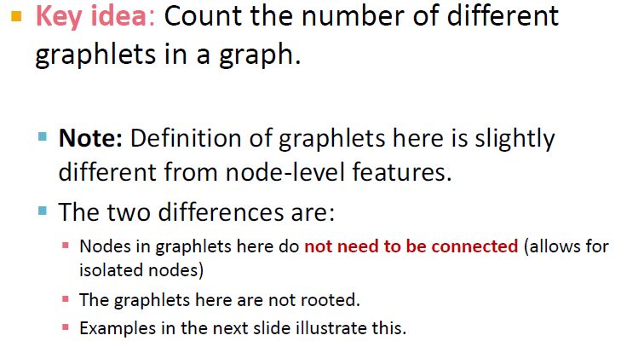
Graphlet features

Slide 37
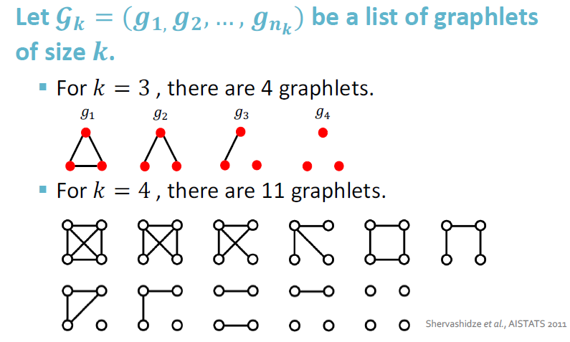
Graphlet features Example

Slide 38
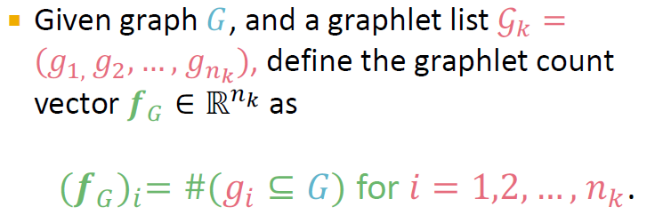
Graphlet features

Slide 39
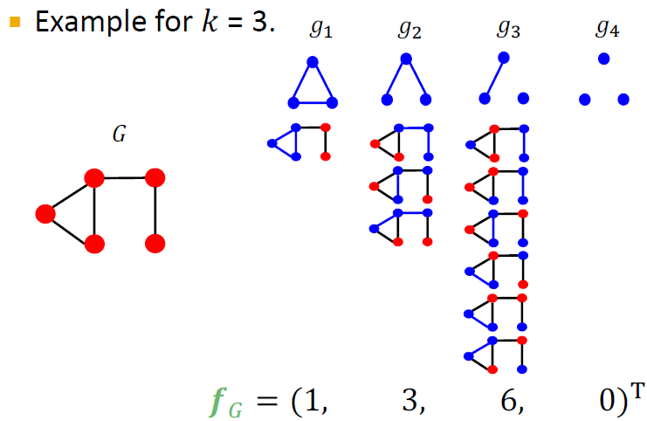
Graphlet Features

Slide 40
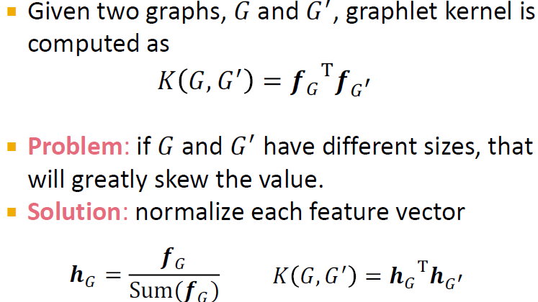
Graphlet Kernel

Slide 41
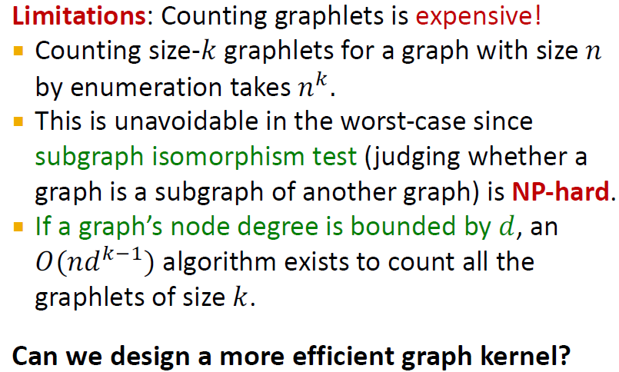
Graph Kernel

Slide 42
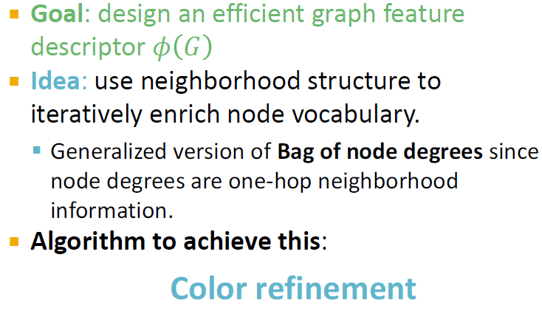
Weisfeiler-Lehman Kernel

Slide 43
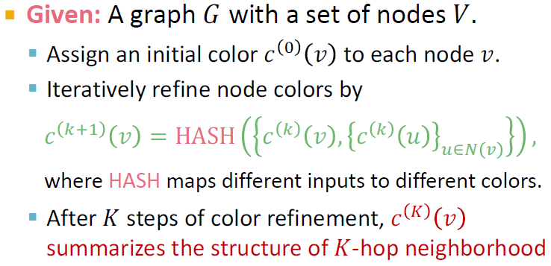
Color refinement

Slide 44
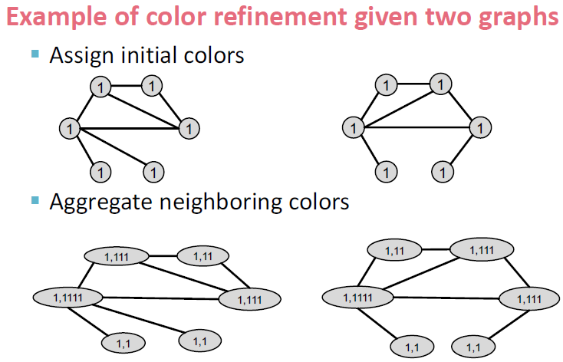
Color refinement

Slide 45
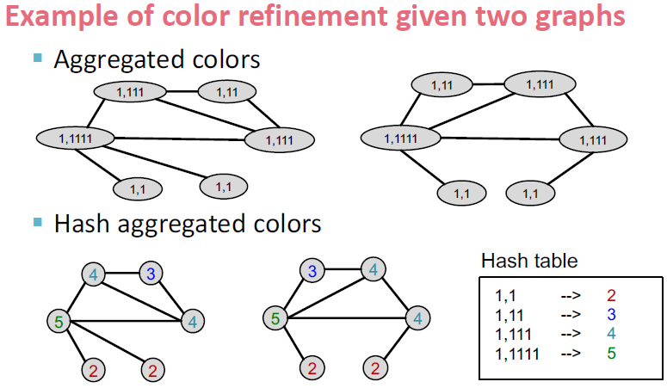
Color refinement

Slide 46
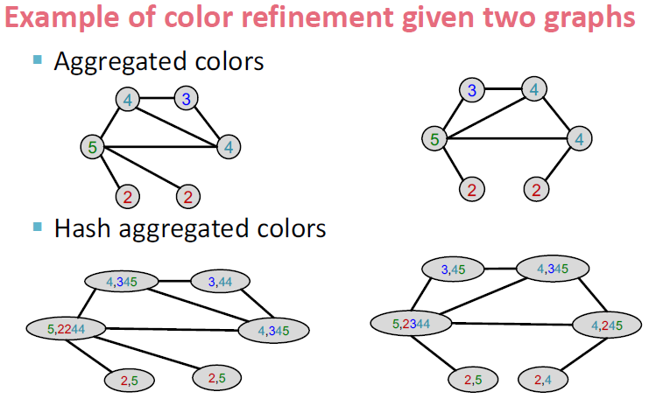
Color refinement

Slide 47
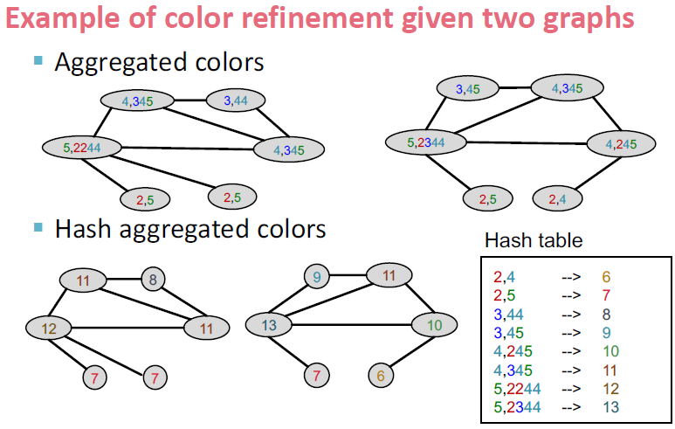
Color refinement

Slide 48
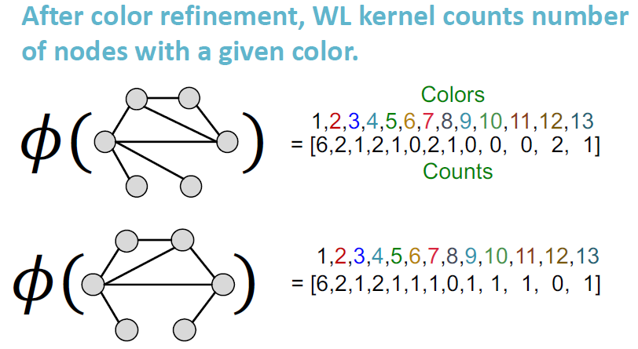
Weisfeiler-Lehman Graph features

Slide 49
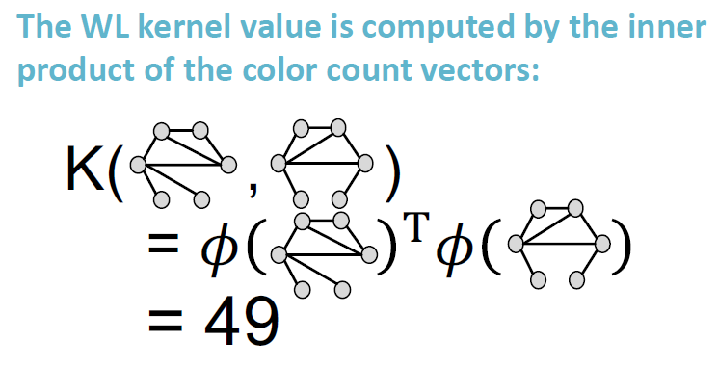
Weisfeiler-Lehman Kernel

Slide 50
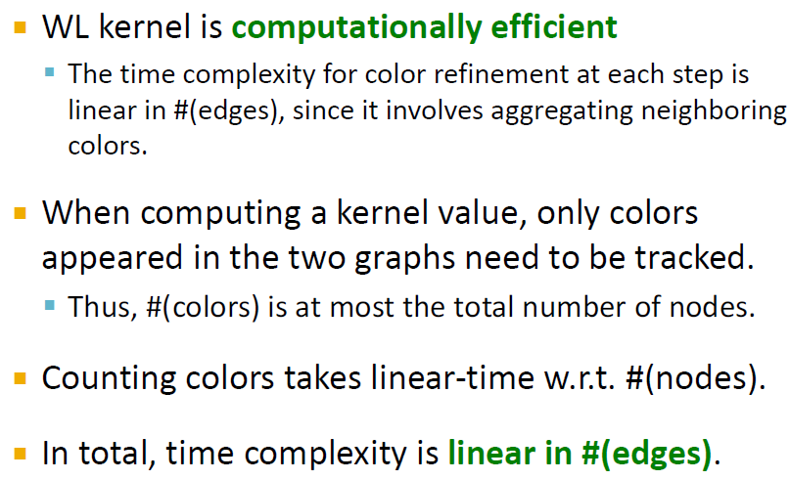
Weisfeiler-Lehman Kernel

Slide 51
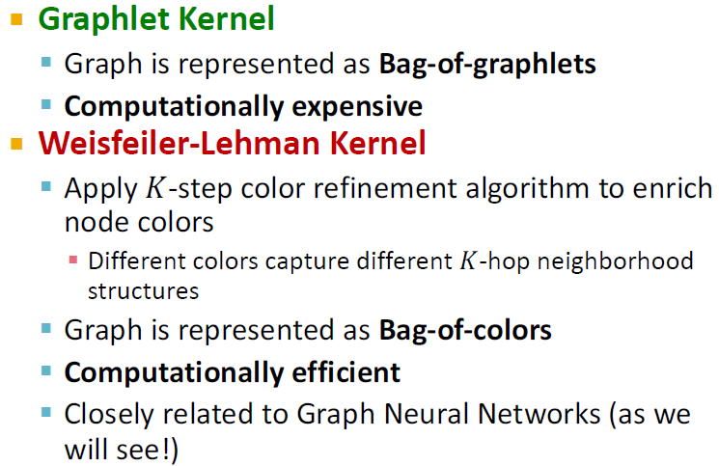
Graph Level features summary

